Slide 1





October 9, 2025
SPACEX FALCON 9 LANDING,
EXUMA SOUND
ENVIRONMENTAL IMPACT ASSESSMENT PUBLIC CONSULTATION MEETING
NEW PROVIDENCE, QUEEN’S COLLEGE PRIMARY HALL
ELEUTHERA, ELEUTHERA DISTRICT HEADQUARTERS BALLROOM

Slide 2

Closed Captioning
Closed Captioning
To turn on closed captions, click on the “CC/Live Transcript” icon on the bottom of your screen
Choose the “enable” option

Slide 3

Zoom Platform
If you need help with the Zoom platform:
Use the chat feature at the bottom of the screen to message meeting host
Meeting ID: 891 0391 9520
Password: 331 299
All participants are on mute and video feeds are restricted

Slide 4
Question and Answer Period
A Q&A period will follow the presentations
If you have a clarifying question, type it into the Q&A box at the bottom of the Zoom screen
Questions can be typed throughout the meeting
Please note: this meeting is being recorded

Slide 5
Welcome & Invocation
Department of Environmental Planning & Protection (DEPP)
Introductions
DEPP
SpaceX
Bron Ltd. (BRON)
The Heritage Partners (THP)
Project Description
Environmental Setting
Impact Assessment
Question & Answer Period
Closing Remarks
MEETING AGENDA
SPACEX EIA PUBLIC CONSULTATION MEETING

Slide 6
INTRODUCTIONS
Department of Environmental Planning and Protection (DEPP)
•Dr. Rhianna Neely-Murphy, Director
•Mr. Arana Pyfrom, Assistant Director
•Mr. Tavaris Miller
•Ms. Keysha Charles
•Mr. McCallton Demeritte
Bron Ltd. (BRON)
•Ms. Agnessa Lundy
•Ms. Kelli Armstrong
•Ms. Elise Roberts
Mrs. Garbrielle Collie
Mrs. Allanique Brown
SpaceX
•Kiko Dontchev
•Katy Groom
•Sheila McCorkle
•Brian Pownall
•Jack Healy
The Heritage Partners (THP)
•Ms. Andrea Moultrie
•Ms. Francine Russell
SPACEX EIA PUBLIC CONSULTATION MEETING
6

Slide 7
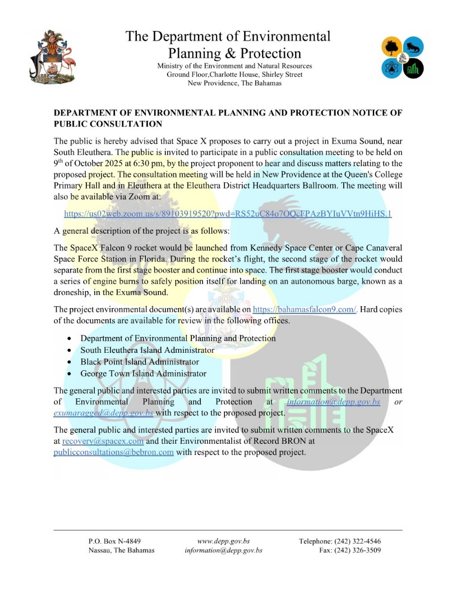
Public Consultation Process
EIA posted online on September 16, 2025.
Public Notice published on the following days.
September 19, 2025 (Tribune and Nassau Guardian)
September 22, 2025 (Tribune)
September 23, 2025 (Nassau Guardian)
September 25, 2025 (Tribune & Nassau Guardian)
September 29, 2025 (Tribune & Nassau Guardian)
October 2, 2025 (Tribune & Nassau Guardian)
October 8, 2025 (Tribune & Nassau Guardian)
SPACEX EIA PUBLIC CONSULTATION MEETING
7

Slide 8
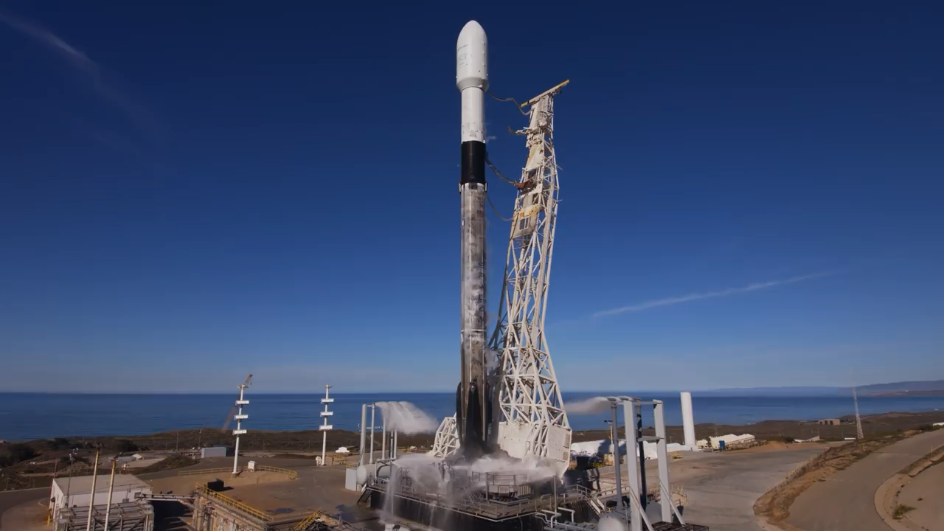
TOTAL LAUNCHES
LANDING SUCCESS
PAYLOAD MASS TO SPACE
540+
98%
11M+
SpaceX is the world’s leading launch services provider with its reliable, reusable rockets and is developing the fully and rapidly reusable rockets necessary to transform humanity’s ability to access space into something as routine as air travel.
SpaceX has successfully landed Falcon rockets over 514 times when we have attempted to land a Falcon first stage booster.
SpaceX has successfully delivered ~11 millions pounds and counting to orbit, including flying critical cargo and astronauts to the International Space Station, launching commercial and government satellites that directly impact everyday life here on Earth, and deploying 8,000+ Starlink satellites to support our global internet constellation.

Slide 9
Fairing
Second Stage
Interstage
4 Grid Fins
First Stage
4 Landing Legs
9 Merlin Engines
9

Slide 10
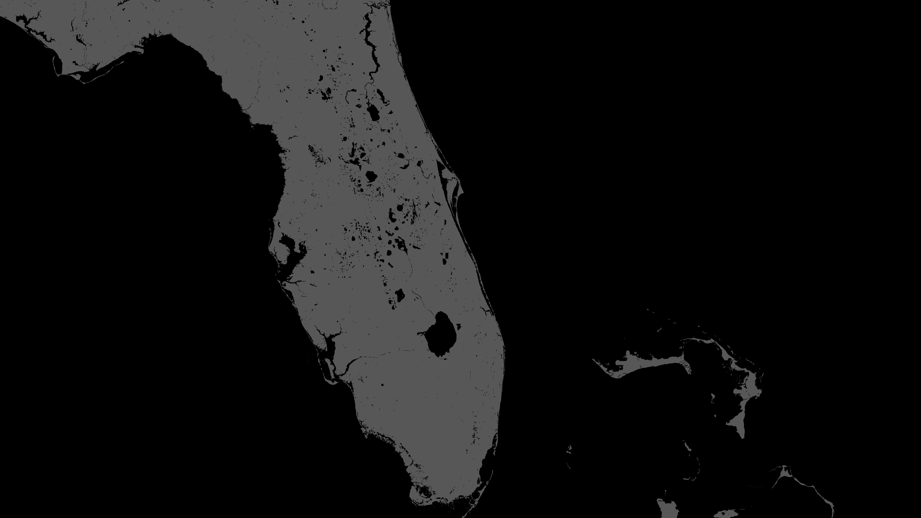

EAST COAST
LANDING & LAUNCH
ATLANTIC OCEAN
LAUNCH COMPLEX 39A
SPACE LAUNCH COMPLEX 40
Orlando
LANDING ZONE 2
AUTONOMOUS DRONESHIPS
GULF OF AMERICA
10

Slide 11
LAUNCH AND LANDINGS
11

Slide 12
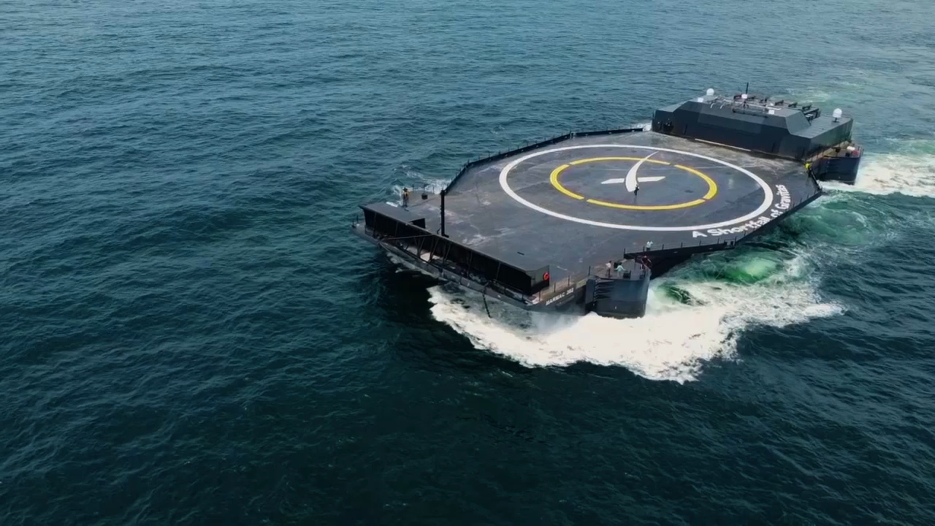
DRONESHIPS
01
JUST READ THE INSTRUCTIONS
Atlantic Ocean
02
A SHORTFALL OF GRAVITAS
Atlantic Ocean
03
OF COURSE I STILL LOVE YOU
Pacific Ocean
12

Slide 13
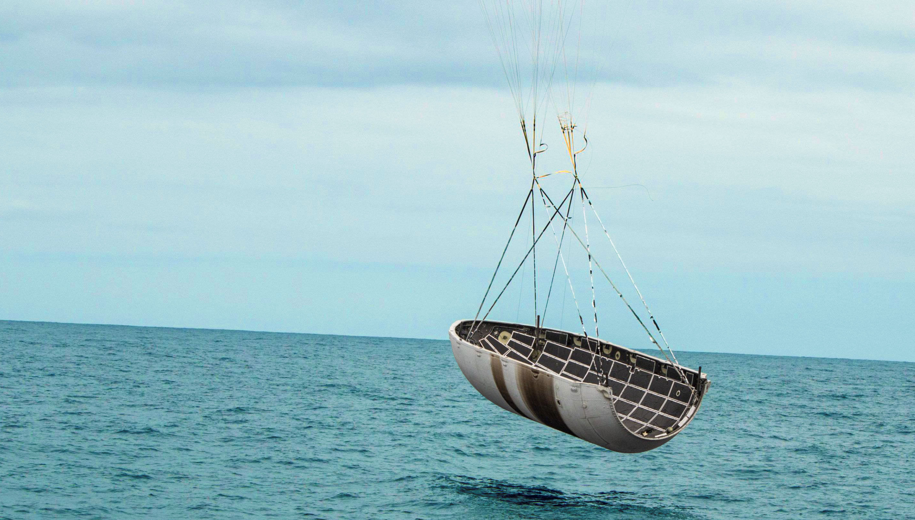
FAIRING RECOVERY
Fairing halves descend with parachutes, enabling a soft splashdown
Each fairing half and parachute are recovered for reuse on future missions
In 2024, 94% of our fairing halves were recovered from the Atlantic and Pacific Oceans
13

Slide 14
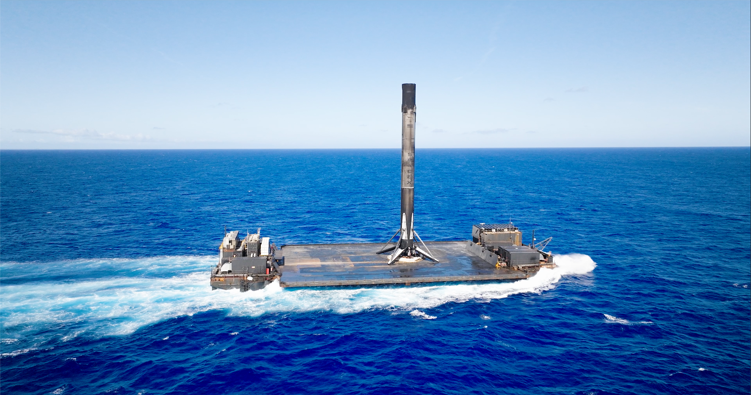
LANDING IN EXUMA
Distance from populated areas ensures public safety
Reliably calm sea-state
Deep water
Enables optimal trajectory for satellite deployment
14

Slide 15
Understanding the Area
Environmental Setting
Benthic Profile (Seafloor Environment)
Offshore benthic environment - sandy-bottom with occasional seagrass meadows and numerous patch reefs in the shallow bank areas.
As the water gets deeper, around 100 feet and beyond where the bottom falls to several thousand feet, those seagrass and coral areas become much less common. At that depth, the seabed starts to change into what’s called the continental shelf. This deeper shelf area has a harder, mostly bare sand bottom surface, with a very occasional rare, isolated head.
The shelf habitat refers to the submerged part of the marine continental shelf that extends from the shoreline extending out where the seafloor drops off steeply into the deeper ocean.
SPACEX EIA PUBLIC CONSULTATION MEETING
15

Slide 16
Understanding the Area
Environmental Setting
Presence of Species of Economic Importance and Protected Species
Marine Mammals, Pelagic Sharks, Deep Sea Corals, Fish Species Avian Species
Proximity to Important Bird Areas (IBAs) and Biodiversity Areas
IBAs “key sites for the conservation of bird species, identified through the BirdLife International IBA programme.”
A review of the Birdlife Country Profile shows that of the 39 IBAs in The Bahamas, 7 are in proximity to the Project site. # BS018-BS024
Depth Verification
It is characterized by relatively shallow waters, typically ranging from a few feet to a few thousand feet in depth and has proven a very difficult environment to study due to the extreme adverse conditions. ~7,000 ft / 2,000 m
SPACEX EIA PUBLIC CONSULTATION MEETING
16

Slide 17
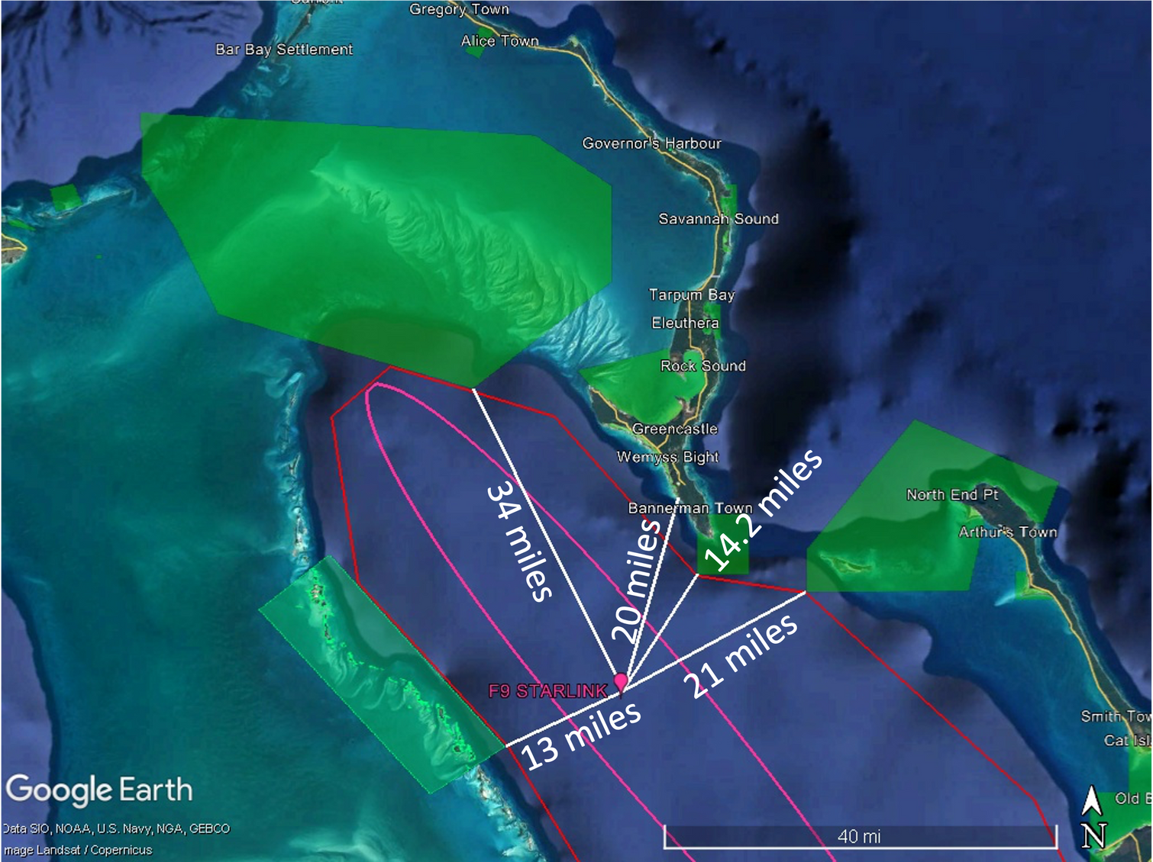
Environmental Setting:
Landing Site
More than 10 miles from Protected Areas.
Exuma Land and Seas Park – Exuma
West Schooner Cays – Eleuthera
Deep Creek - Eleuthera
Southeast Eleuthera/The Bridge – Eleuthera
Orange Creek – Cat Island
More than 20 nautical miles from IBAs in the area (BS018-BS024)
SPACEX EIA PUBLIC CONSULTATION MEETING
17

Slide 18
Summary of Impacts - US
Air Quality
Terrestrial Wildlife
Emissions from landing include nitrogen oxide (NOX) and due to the large area and depth of the atmosphere, disperse to low ambient concentrations. It does not contribute to an exceedance in significant air quality thresholds.
(Birds) Temporary increase in vigilance and alert behavior; (Mammals) Short-term increase in heart rates and shifts in resting and movement behaviors of ungulates
Noise Quality
Marine Wildlife
Acoustics (Sound in Air) - Within the anticipated range of 100–110 dBA and below occupational hazard thresholds.
Hydroacoustics (Sound in Water) - Acoustic energy in the air does not effectively cross the air/water interface and most of the noise is reflected off the water surface (Richardson et al. 1995).
Species could be exposed to the overpressures from sonic booms in the air when they are surfacing for air; however, the chances of both events happening at same time (i.e., species surfacing and a sonic boom occurring) is extremely unlikely.
Marine Transportation
Temporary marine access restriction in the Landing Hazard Area (LHA).
Water Quality
Waste Impact
Any residual fuels remain in the vehicle and do not affect water quality.
No evidence of marine debris, liquid waste discharge, or hazardous material before, during, or after successful landings.
SPACEX EIA PUBLIC CONSULTATION MEETING
18

Slide 19
Summary of Impacts – The Bahamas
Air Quality
Terrestrial Wildlife
Results showed no measurable degradation of air quality attributable to the Falcon 9 landing or its associated support vessels.
Decline in avian abundance was observed across all sites after the launch, but less point counts were conducted post launch due to several extenuating circumstances.
Noise Quality
Marine Wildlife
Acoustics (Sound in Air)- Within the anticipated range of 100–110 dBA stated in the baseline and well below occupational hazard thresholds.
Hydroacoustics (Sound in Water) - Acoustic energy in the air does not effectively cross the air/water interface and most of the noise is reflected off the water surface (Richardson et al. 1995).
Marine Mammals were not observed.
Flying fish were observed daily.
Marine Transportation
Temporary marine access restriction in the Landing Hazard Area (LHA).
Waste Impact
Water Quality
No evidence of marine debris, liquid waste discharge, or hazardous material before, during, or after the February 2025 SpaceX Falcon 9 landing.
No significant impact on water quality, an assessment that was confirmed by the results of the Post Launch Report (PLR).
SPACEX EIA PUBLIC CONSULTATION MEETING
19

Slide 20
In-Water Sound
Not all noise in the air goes into the water. Sound traveling through air hits the water surface and most of it bounces back into the air instead of penetrating.
Why this happens:
Air and water have different densities
This “mismatch” means sound waves lose energy when trying to cross from air to water.
As a result, most of the rocket’s sound reflects off the surface.
Only a small portion of the noise enters the water with he strongest sounds remaining in the air above the surface.
How does sound propagate from air into water?
Link: https://dosits.org/science/movement/how-does-sound-propagate-from-air-into-water/
How does sound in air differ from sound in water? – Discovery of Sound in the Sea
Link: https://dosits.org/science/sounds-in-the-sea/how-does-sound-in-air-differ-from-sound-in-water/
SPACEX EIA PUBLIC CONSULTATION MEETING
20

Slide 21
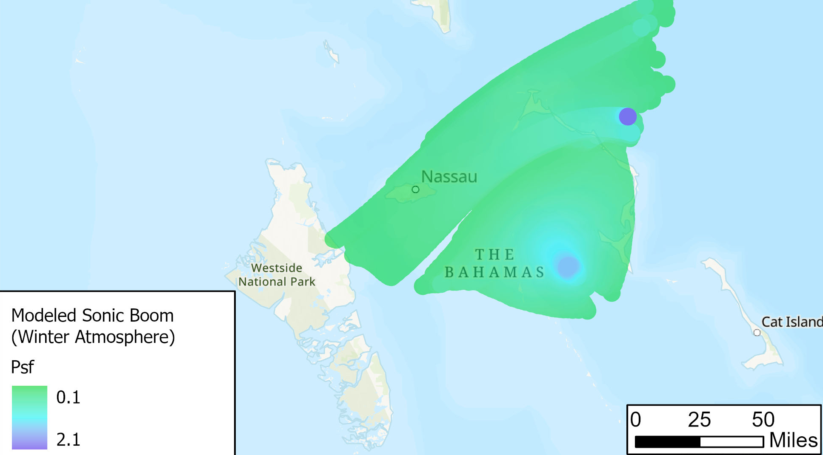
SONIC BOOM PREDICTIONS

Slide 22
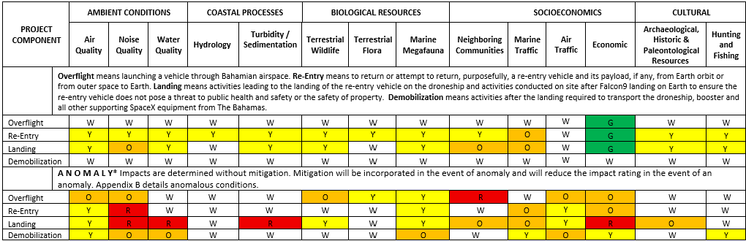
SUMMARY IMPACT TABLE
Significance - a determination of the degree of importance assigned to an environmental impact resulting from project related activities
Impact Significance Key | Negligible / Not Applicable White (W) | Beneficial Green (G) | Minor Yellow (Y) | Moderate Orange (O) | Negative Red (R)
SPACEX EIA PUBLIC CONSULTATION MEETING
22

Slide 23
Key Takeaways
February 18, 2025 mission was a Nominal Scenario
No Red Severe Impacts anticipated
Orange Moderate Impacts are associated with the sonic boom in air and temporary access restriction near the droneship during overflight and landing.
White Negligible Impact on air traffic.
General Note
Only Liquid Oxygen remains in the rocket during the landing. This will dissipate as it is vented onto the droneship.
The threshold for structural damage is 2psf. There are no structures in the areas that were modelled to experience ~ 2 psf .
Anomaly Scenarios
SpaceX is responsible for all clean up activities in the event of an anomaly.
SPACEX EIA PUBLIC CONSULTATION MEETING
23

Slide 24

Stakeholder Engagement
The general public will be notified in advance of a scheduled sonic boom.
Community-based sound mapping exercise is proposed in response to anticipated sonic booms.
Members of the public will be invited to document their personal experiences of the sound event.
Spatially distributed qualitative data will be collected to supplement traditional acoustic modeling or monitoring.
SPACEX EIA PUBLIC CONSULTATION MEETING
24

Slide 25
Proposed Mitigation Strategies
Acoustic Impact Monitoring
Wildlife Surveys and Timing Controls
Future launches will incorporate calibrated hydrophone systems deployed at multiple depths and distances from the landing site to assess sound exposure levels in standardized units (dB re 1 µPa).
Pre- and post-landing avian and wildlife surveys will be conducted one week before and after the second launch to detect disturbances or displacement. Special attention will be paid to nesting birds and migratory species anticipated for the time of year the landing occurs.
Debris Contingency Planning
In the unlikely event of an anomaly or rocket failure, which has a historically low probability given Falcon 9's proven reliability (>450 successful landings), a debris recovery plan will be initiated.
Habitat Access Control
Ground operations associated with recovery will be confined to designated access routes and cleared areas to prevent trampling or disruption of coastal vegetation and dune systems, if necessary.
Marine Species Monitoring
Post-activity surveys will be conducted to observe any abnormal behavior or displacement of marine fauna, including dolphins, sea turtles, or reef fish.
SPACEX EIA PUBLIC CONSULTATION MEETING
25

Slide 26

Local hotels, restaurants, and service providers indicated an increase in activity as spectators and support personnel traveled to the area to witness the landing.
The deployment of Starlink terminals in Bahamian schools directly improves digital infrastructure, which is part of SDG 9 (Industry, Innovation, and Infrastructure). United Nations Sustainable Development Goal (SDG) 9.c.1 - expanding affordable access to the internet and ICTs (information and communications technologies), particularly in least developed countries (LDCs).
In support of The Bahamas National Development Plan (Vision 2040) and the SDGs, SpaceX aims for future missions to expand educational partnerships, promote local capacity in environmental sciences.
The Project includes educational outreach and STEM learning opportunities, advancing environmental education, which is referenced in SPAW Protocol Article 13: “The Parties shall... promote education, training and public awareness.”
$1 million donation to the University of The Bahamas.
Opportunities & Project Benefits
SPACEX EIA PUBLIC CONSULTATION MEETING
26

Slide 27
Q&A Follow Up
Questions and comments may be submitted by email to:
information@depp.gov.bs
exumaragged@depp.gov.bs
recovery@spacex.com
publicconsultations@bebron.com
Please add “Bahamas Falcon 9” in the email subject.
The EIA is available for review online at:
https://bahamasfalcon9.com/
27

Slide 28
QUESTION & ANSWER SESSION
If you have a question, please raise your hand and wait to be called on
When asking your question, please proceed to the microphone and state and spell your first and last name
Please indicate if you represent an agency or organization
For Zoom participants, if you have a clarifying question, type it into the Q&A box at the bottom of the Zoom screen
Comments received up to 21 business days after today will be responded to and included in the Public Consultation Report which will be submitted to DEPP.
28

Slide 29

Closing Remarks
Comments received up to 21 business days after today will be responded to and included in the Public Consultation Report which will be submitted to DEPP.
Physical comments brought to the DEPP office must be submitted by 5:00 PM on Monday, November 10th, 2025.
Electronic comments must be time-stamped no later than 11:59 PM on Monday, November 10th, 2025.
The end of Public Consultation Period is Monday, November 10th, 2025.
SPACEX EIA PUBLIC CONSULTATION MEETING
29

